Slide 1
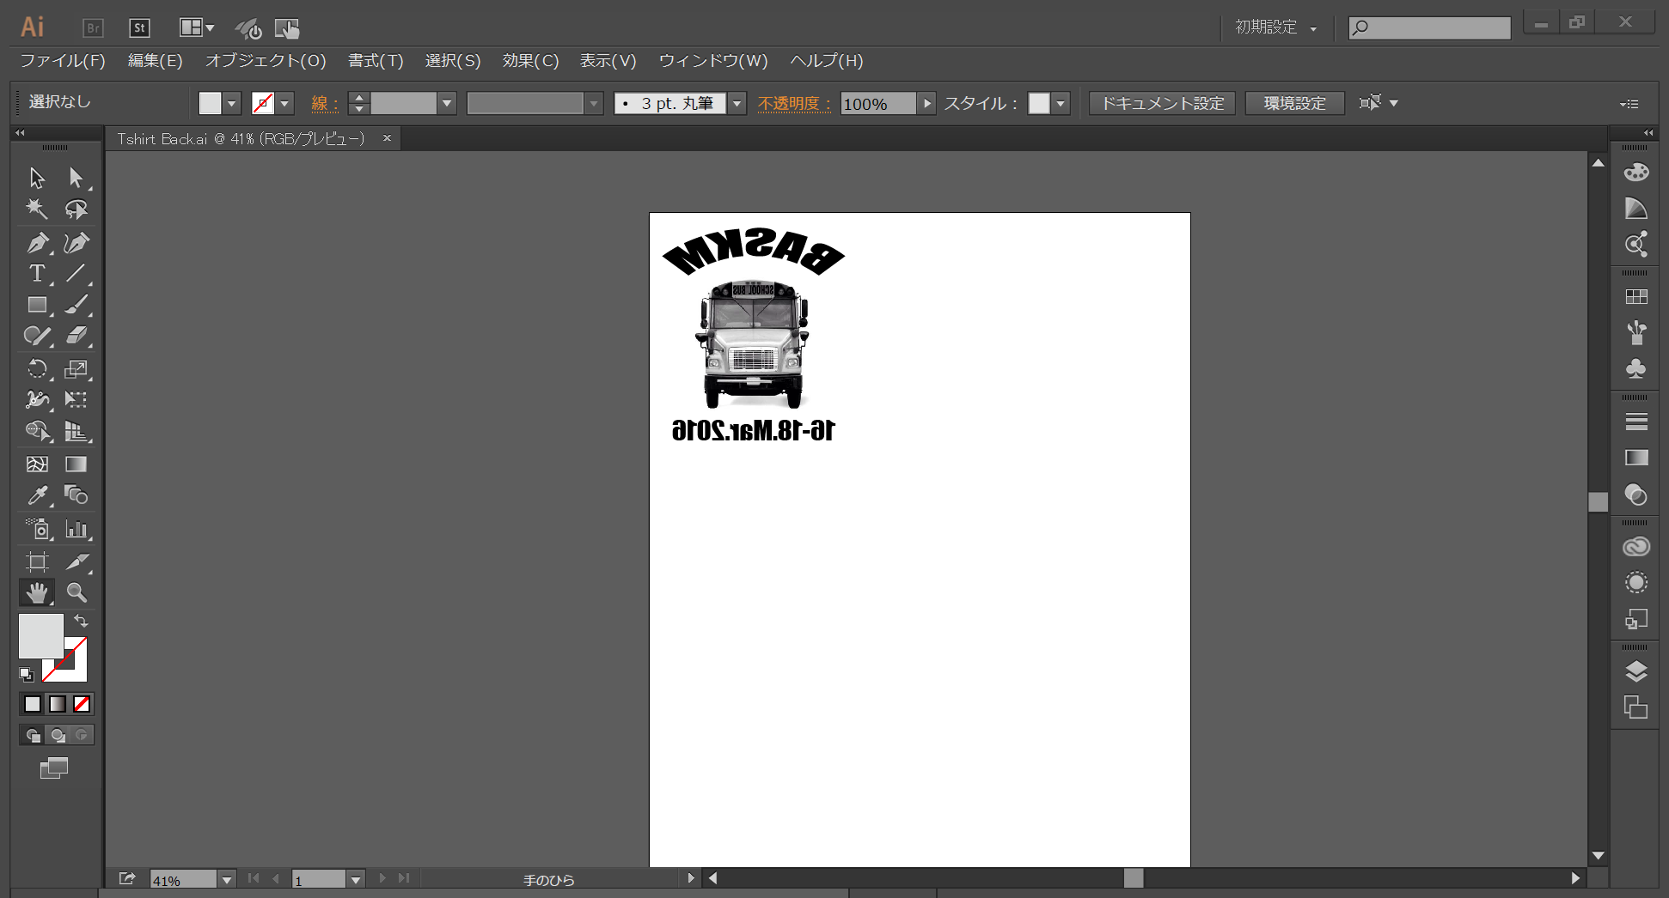
“ASOBO”Project
Team BASKM

Slide 2
Team
Tri-continental hackathon

Slide 3

What team? Wildcats.
team
Bryan Li
Miki Matsumoto
Columbia University
Computer Science
Pop music violinist
Columbia University
Biochemistry
Is secretly Banksy
Sebastian Cueva
Kevin Chu
Ayaka Otani
Columbia University
Computer Science
Expert wine taster
Columbia University
Computer Science
Growth hacker
Columbia University
Economics
Starship captain
Sponsored by

Slide 4


Contents
Context
Fact
Product
Design
Next Step
Q&A

Slide 5
1.Context

Slide 8


Slide 9
2.Facts

Slide 10


Fact : Children left in cars are suffered by heat stroke
In U.S., around 30 children are killed by heat stroke every year.
The number of injuries is 50 times as much as death.
Source: National Highway Traffic Safety Administration

Slide 11
Fatalities& Injuries by Non-traffic incidents IN U.S(Under 15 years)
・Fatalities
・Injuries
Source: National Highway Traffic Safety Administration

Slide 12
3.Product

Slide 13
Product:”ASOBO“ Alert parents when their babies are in danger
Input
Output
Data measured by Sensors
Temperature
Humidity
Shock
Alert
Send Mail to parents
Telephone authority
Smart memory
Predict temperature by last 30seconds data and call parents “before” danger.
ASOBO

Slide 14
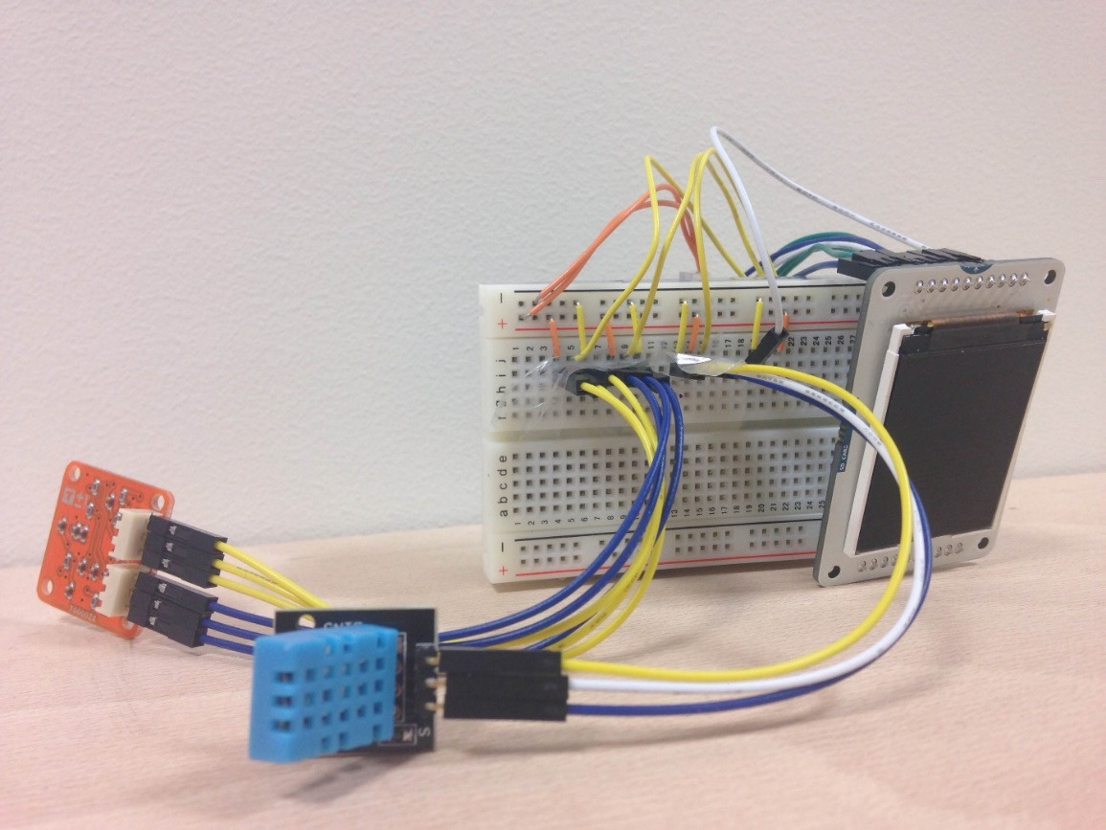
Equipment inside “ASOBO”
Arduino
Yun
Shock Sensor
Temperature & Humidity Sensor
Screen

Slide 15
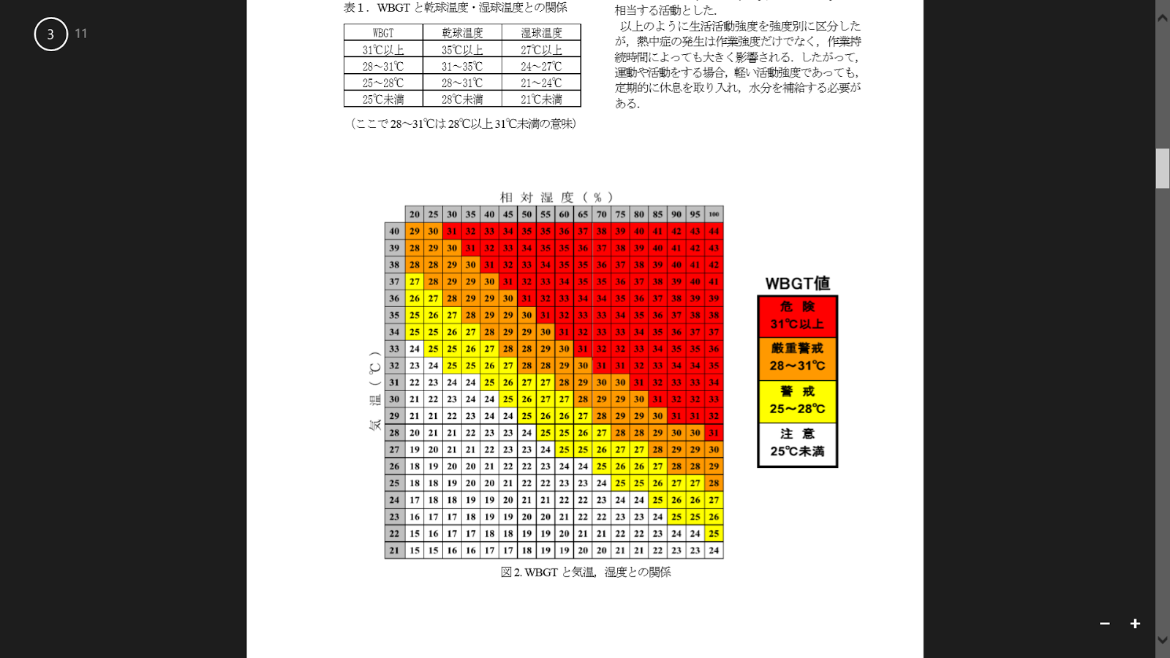
Input: Measure temperature and humidity
“ASOBO” can recognize danger levels,
to take proper measures for each level
Humidity(%)
Temperature(℃)
WBGT index
Severe Danger
Danger
Warning
Safe
Level
Source : Japan ministry of environment

Slide 16
Input: Measure shock Slide
“ASOBO” can sense when a child is in the car
The built in accelerometer, upon sensing movement, will turn on the temperature sensing functionality (if no movement, it is off to save power).

Slide 17
ENGINEERING(Output)): Give different alert for each level of danger
Level | Alert
Severe Danger | Send Severe Emergency Message Telephone Authority
Danger | Send Severe Emergency Message Telephone Authority
Warning | Send Emergency Message

Slide 18
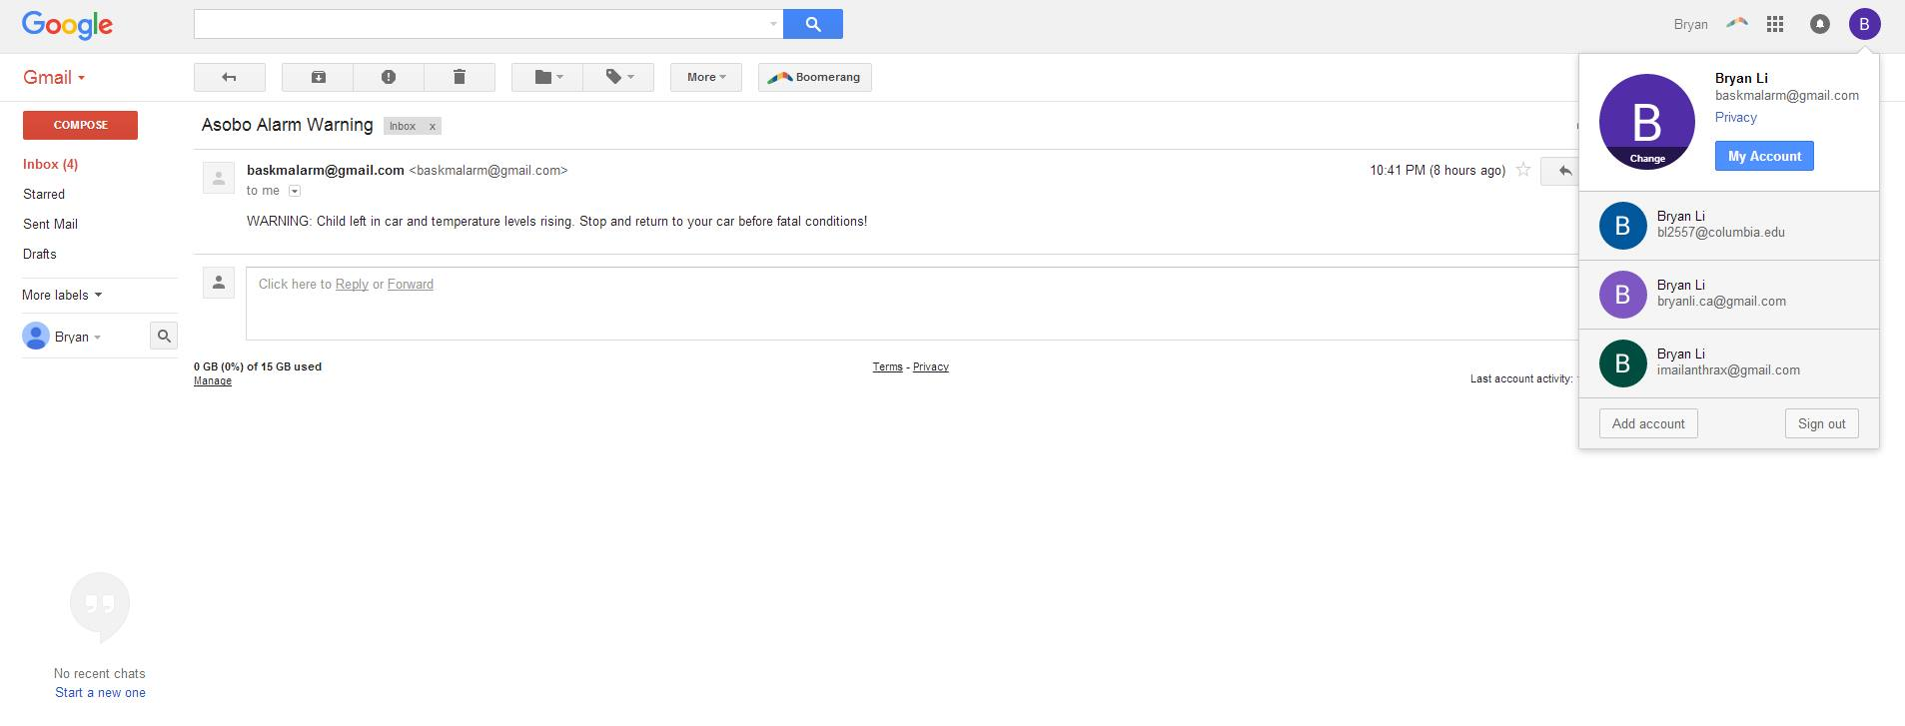
Alert mail to parents

Slide 19
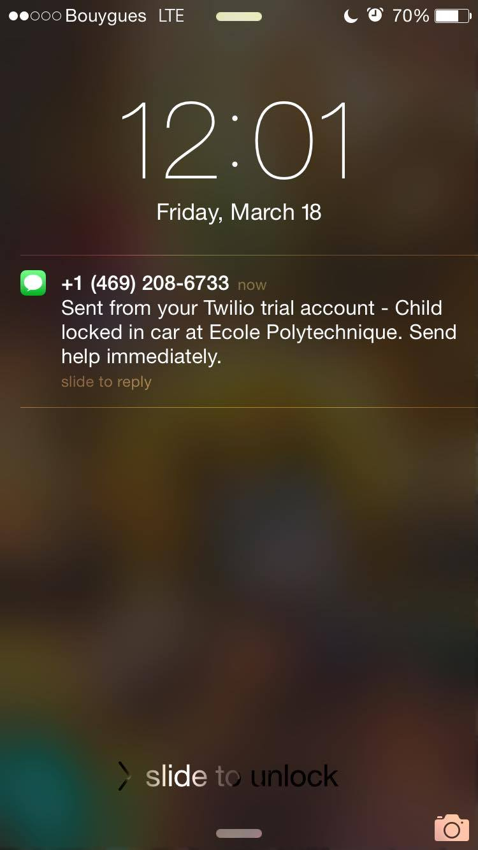
Alert SMS for Authority

Slide 20
ENGINEERING(Output)): smart memory can predict danger and alert in advance
”ASOBO" features smart memory that will determine if temperature levels have been rising in the past 30 seconds.
If so, it will alert the parents to come before the temperature increases more.
This way, we can alert parents *before* the problem occurs.

Slide 21
4.Design

Slide 22
Design:
・ ・ Smile…Normal(white)
・ ・ Neutral…Warning(Yellow)
・ ・ Frown… Danger/Severe Danger
(Orange/Red)
Face
Moving
Hands
ASOBO
Key Value: Human-Centric
Children can play with “ASOBO”as a toy
“ASOBO”emphasizes caring, for fun and for saving lives.
Round Shape
Mesh
Structure

Slide 23
5.Next Step

Slide 24
Next step
Material of “ASOBO”’s shell
Refined type:
Rubber&3D print
Prototype:
plexiglass & lazer cutter
Apply to other article
Future models can have different looks -- portable technology!
It could be in a dog toy, in licensed stuffed animals, etc. Scalable design!

Slide 25
6.Q&A

Slide 26
How much does it Cost?
Total Cost is 77€! < Child’s life
ArduinoYun:52€
Temperature & humidity sensor:7€
Shock sensor:6€
Small screen:8€
Plexiglas 5mm transparent (150mm×200mm):4€

Slide 27
What is WBGT index?
WBGT (Wet Bulb Globe Temperature) Index
Created by U.S. in 1954
WBGT is a composite temperature used to estimate the effect of
1)temperature,
2) humidity,
3)visible and infrared radiation (usually sunlight)on humans.
Purpose is to prevent heat stroke.

